Slide 1
Ethical Hacking
HTTP Response Splitting – CTF challenge
Loïc Guibert November 2020

Slide 2
Context
Root-Me challenge
One goal: obtain administrator access
Web environment

Slide 3
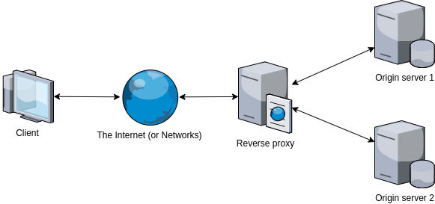
Starting Point
Reverse proxy acting as a cache
Website under development
The admin visits the website periodically

Slide 4
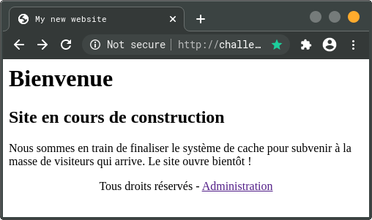
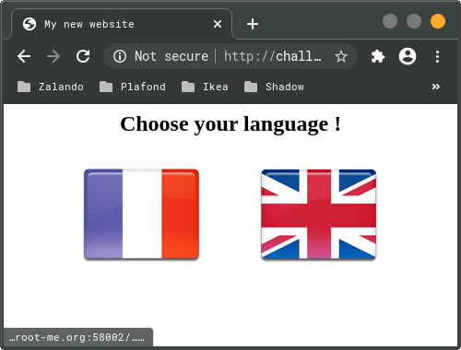
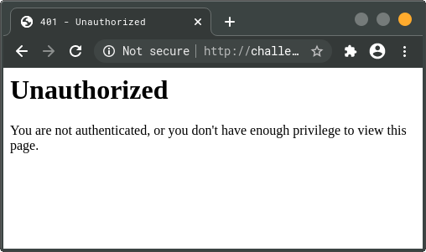
Website
Notes:
On a specific port (58002)
No TLS
GET parameters
Error 401

Slide 5
Checking technologies
Basic HTML pages
Two cookies, unsecured
No server vector
CGI not sanitized & vulnerable to injections
No CSP policy (cross-site scripting)
Notes:
No JS nor CSS

Slide 6
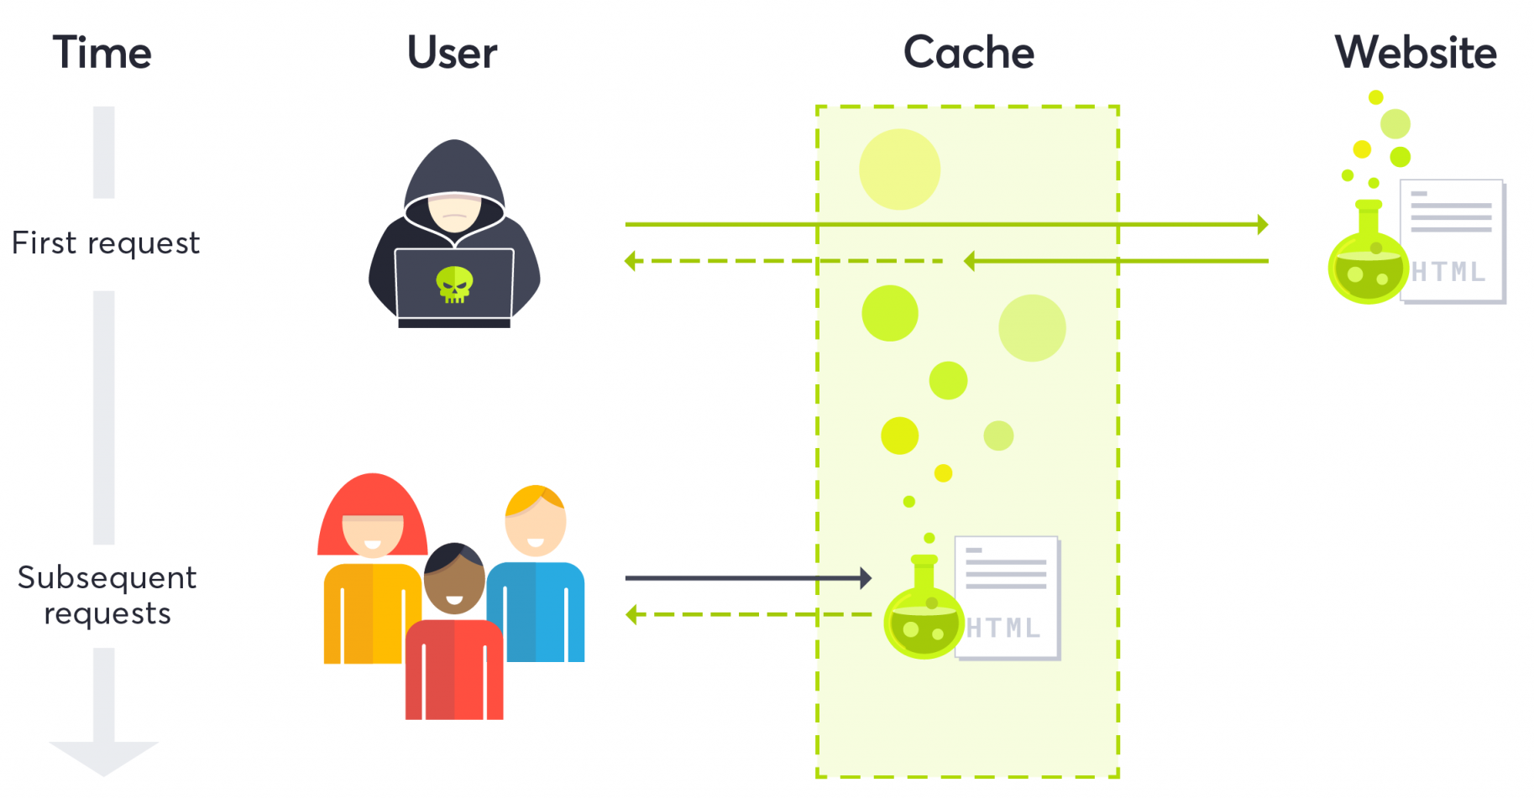
Found attack
Retrieving administrator’s session identifier
Forging JavaScript payload
Inject it
Make it persistent
https://blog.detectify.com/2020/07/28/do-you-trust-your-cache-web-cache-poisoning-explained/

Slide 7
Payload
Get the document.cookie object
Add this to a request
Perform the request

Slide 8
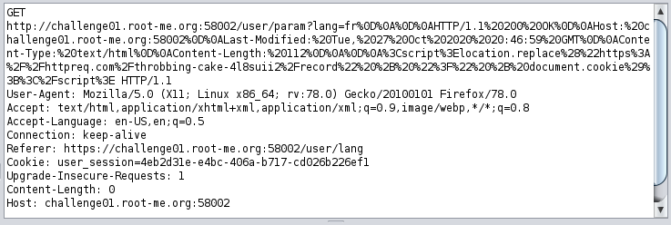
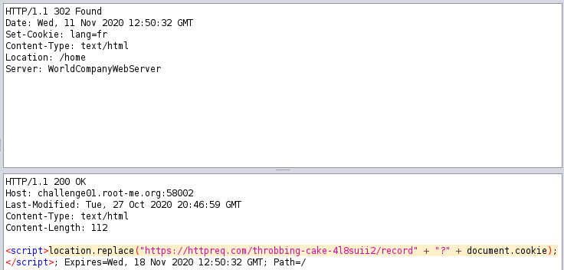
Injection
Redefine HTTP headers
Using CGI lack of sanitization
CRLF injection
Generate a second response

Slide 9
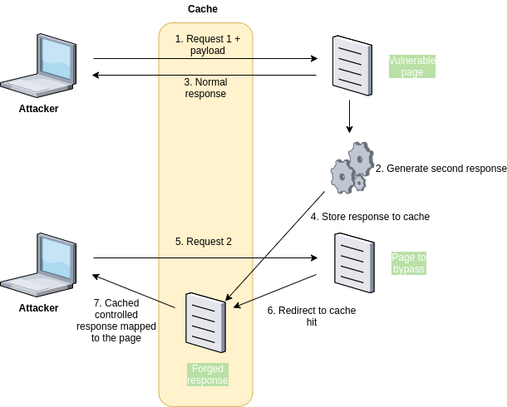
Persistence
Serve controlled response to admin
Adapted HTTP header
Perform a second request after injection

Slide 10
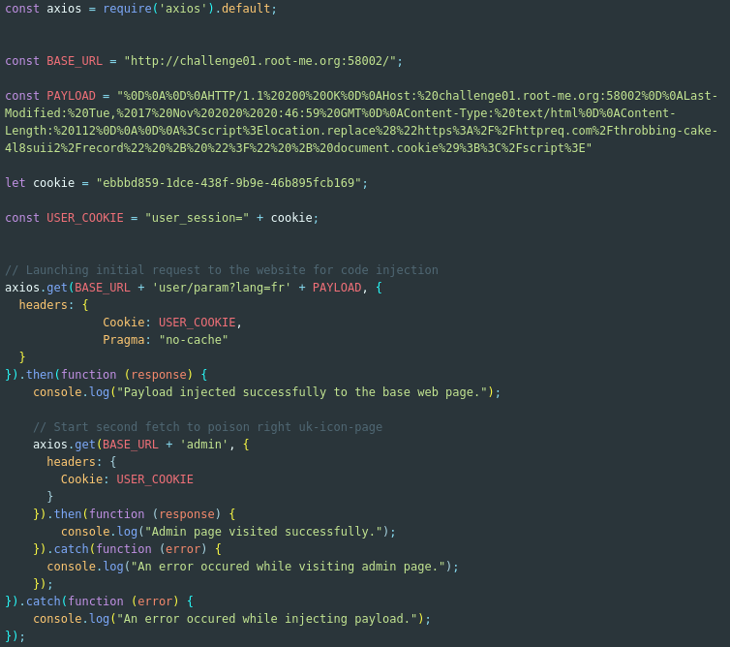
Attack
Node.js application
axios library

Slide 11

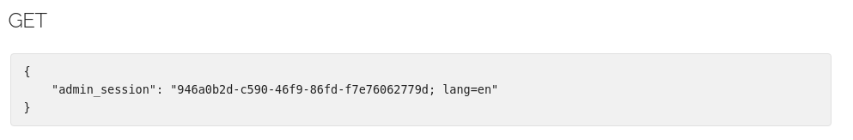
Result
Administration session identifier retrieved

Slide 12
Mitigation
User inputs
Limit cache hits
Securise cookies
Limit system banners

Slide 13
Conclusion

Slide 14
Questions

